Slide 1

Indoor Games
Pawan Mahadu Sarule
Class: FYBCA(Sci)

Slide 2
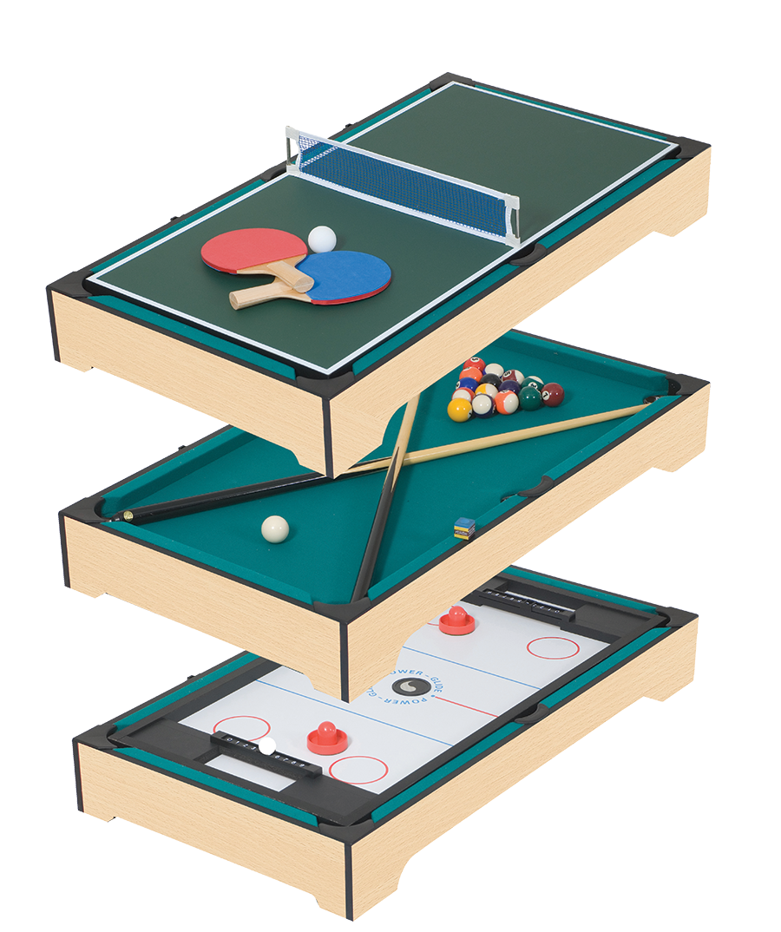
What is Indoor Games?
Indoor games are ones that happen or are used inside a building and not outside.

Slide 3
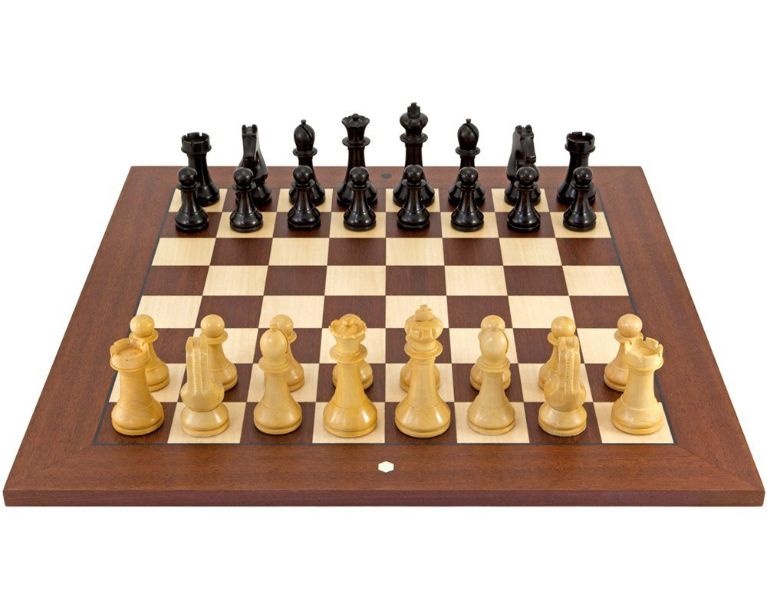
Chess
This game with a stalwart that India can boast of proudly (Vishwanathan Anand) is certainly one of the most mentally taxing and IQ-demanding games.
With roots lying in Ancient India in the Gupta Empire, it was known as ‘chaturanga’- literally meaning four divisions (infantry, cavalry, elephantry and chariotry represented by pawn, knight, bishop and rook).
Its spread into and across Europe did not occur until the 1000s.

Slide 4
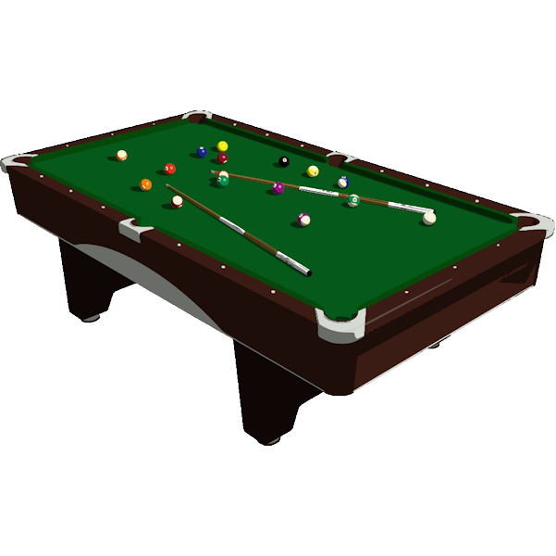
BILLIARDS
A general term used for Carambole Billiards, this is the most popular game from the family of billiards (others include three- cushion billiards, pool, etc).
It is believed to have its origins in France in the late 1700s.
The carambole billiard game (most popular in the family) has a very simple objective- a point is scored (known as count) when the cue ball hits both the object balls in a single stroke.
As soon as a preset number of points is reached the winner is decided.
Other variations of billiards include limited-rail billiards, balkline billiards, cushion carom, three-cushion billiards, etc.

Slide 5
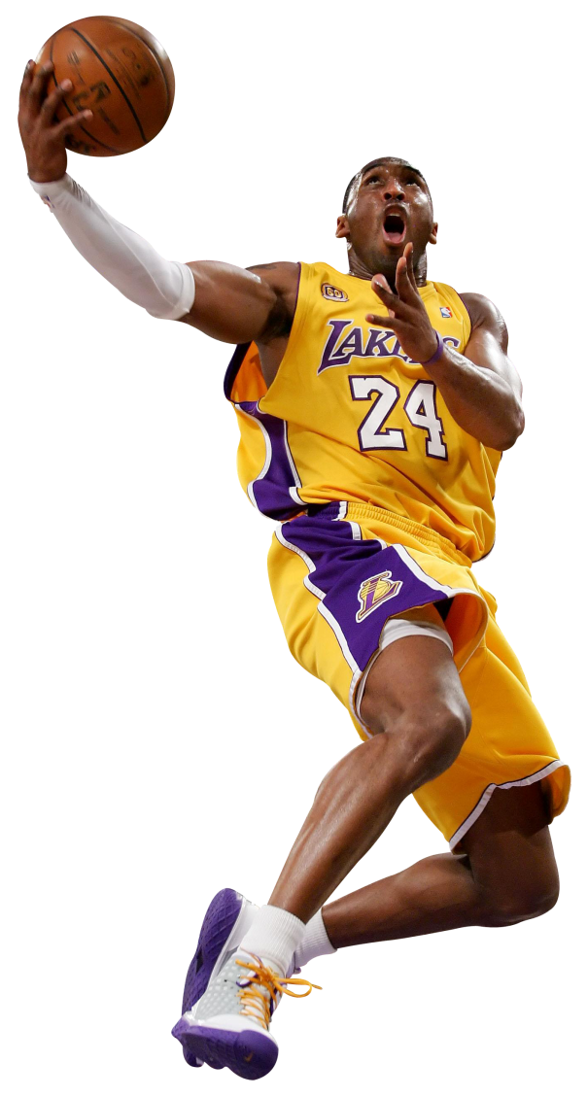
Basket ball
BASKETBALL Basketball was invented by Dr. James Naismith as an activity to keep his students at gym active on a rainy day. The idea was to come up with a sport that wouldn’t be too rough yet would provide the right amount of physical exercise. Originally played with a soccer ball, the traditional brown ball (used exclusively for basketball) came into existence in the late 1950s (introduced by Tony Hinkle). Points are scored by putting the ball in the basket (two points) if it is in front of the three-point line else three-points are scored. Basketball, in western countries, is played at many levels including college and high-school level basketball.

Slide 6
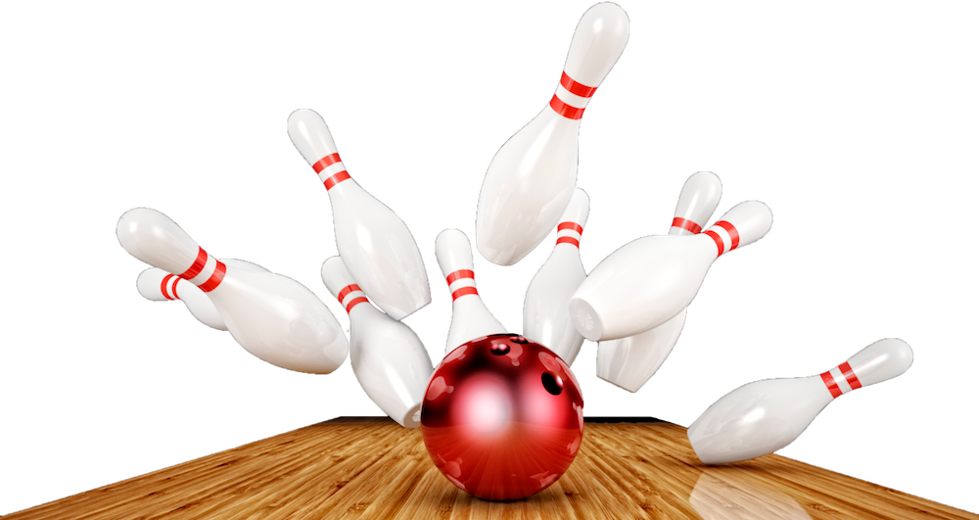
Bowling
To a layman this game might seem like a childish indulgence- getting hold of a humongous ball just to knock over ten odd-shaped pins at the end of an alley hardly qualifies as a game, eh? Wrong.
The sport of bowling has been accepted and is played by over 95 million people across the world, spanning more than 90 countries.
Its roots are in Ancient Egypt (discovered from remains by Sir Flinders Petrie) and also the Roman Empire where the people used husk balls, leather balls, etc.

Slide 7
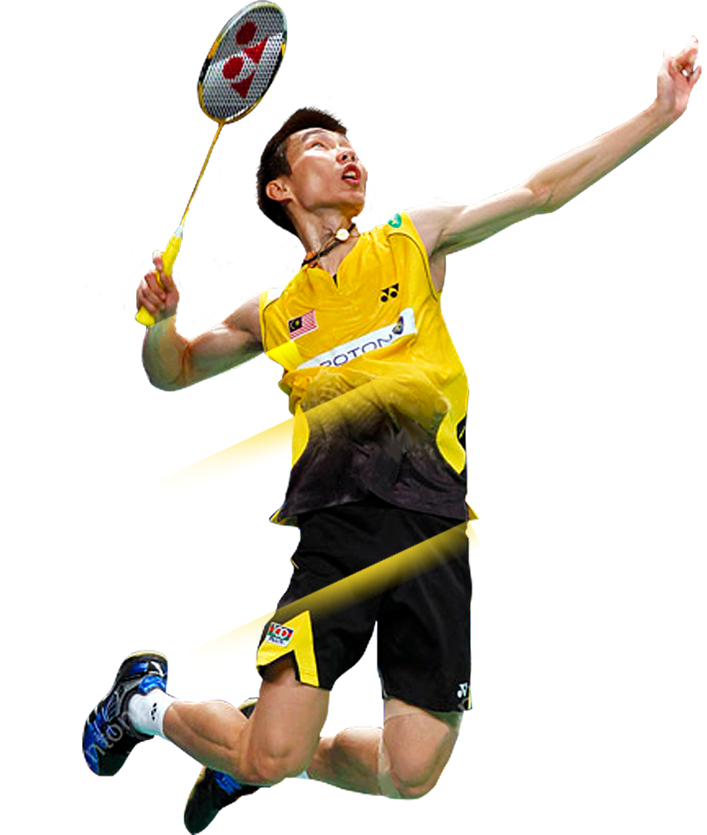
Badminton
Like squash, Badminton is also a racquet sport (played with a shuttlecock instead of a ball).
Opponents are pitted against one another on either side of a net and a point is scored by a player when the shuttlecock is not returned, during a rally, by his opponent.
1992 was the first year when badminton was first introduced in the Olympics.
This sport requires a good deal of agility, reflexes and hand-eye coordination.
It was in British India (early 1800s) when this sport first came into existence.

Slide 8
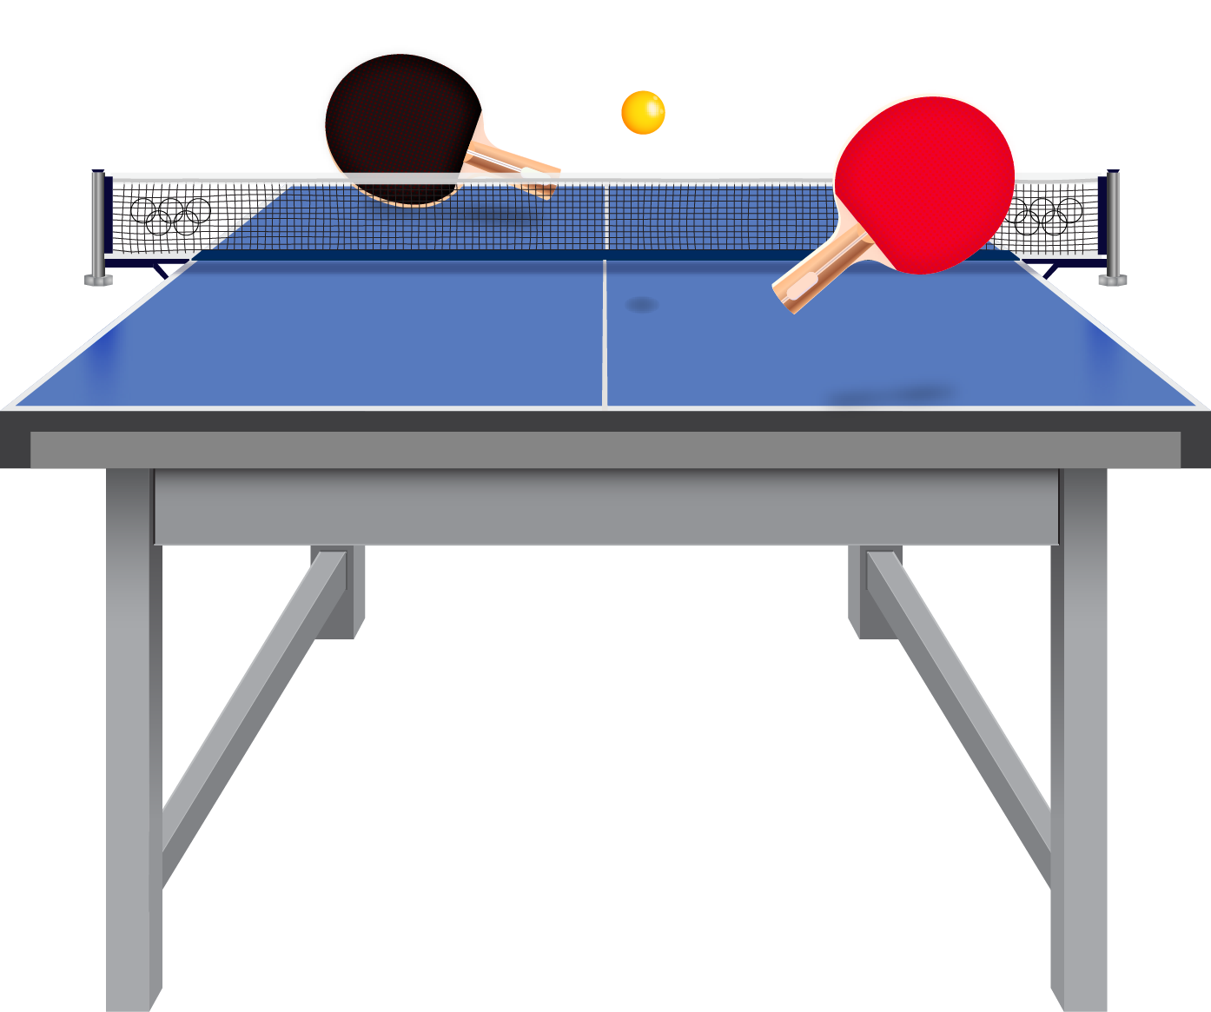
Table Tennis
Analogous to its outdoor counterpart, table tennis can be played by two players (singles) or by four (doubles).
The rules of the game, however, are slightly different. The service must be done in a way so as to make the ball drop once in one’s own half of the board and once in the opponent’s half, and thereafter in the opponent’s half only.
Owing to the sound of the ball being hit to-and-fro between the racquets, this game is also known as ping-pong.

Slide 9

Thank You

